Slide 1
Impedance Spectroscopy
Kitty Harris and Josh Eslarboukh

Slide 2
Phasor Notation

Slide 3
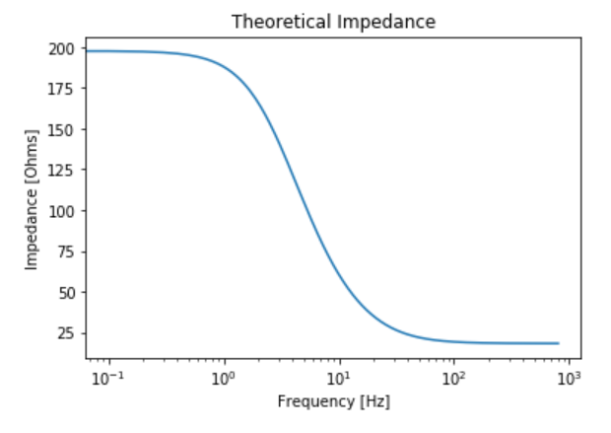


Frequency Dependence of Impedance
Impedance is a measure of how current flow is hindered in a system.
$Z_{series}=\sum_{i}{Z}$ and $\frac{1}{Z_{parallel}}=\sum_{i}{\frac{1}{Z}}$
$Z_{R}=R$ and $Z_{C}=\frac{1}{jωC}$
So, for our system under test, we end up with
$$Z={\left(\frac{1}{Z_{1}}+\frac{1}{Z_{2}}\right)}^{−1}={\left(\frac{1}{R_{1}}+\frac{1}{\frac{1}{jωC}+R_{2}}\right)}^{−1}=\frac{R_{1}\left(1+ω^{2}C^{2}R_{2}\left(R_{1}+R_{2}\right)−jωCR_{1}\right)}{1+ω^{2}C^{2}{\left(R_{1}+R_{2}\right)}^{2}}$$
As frequency approaches zero, the system behaves more like a DC circuit and charge cannot cross the branch containing the capacitor, so $Z≅R_{1}$.
As frequency becomes arbitrarily large, the current can arc across the capacitor, effectively ignoring its presence, and $Z≅\frac{R_{1}R_{2}}{R_{1}+R_{2}}$.
$V=I|Z|$

Slide 4
Lock-In Amplifier

Slide 5
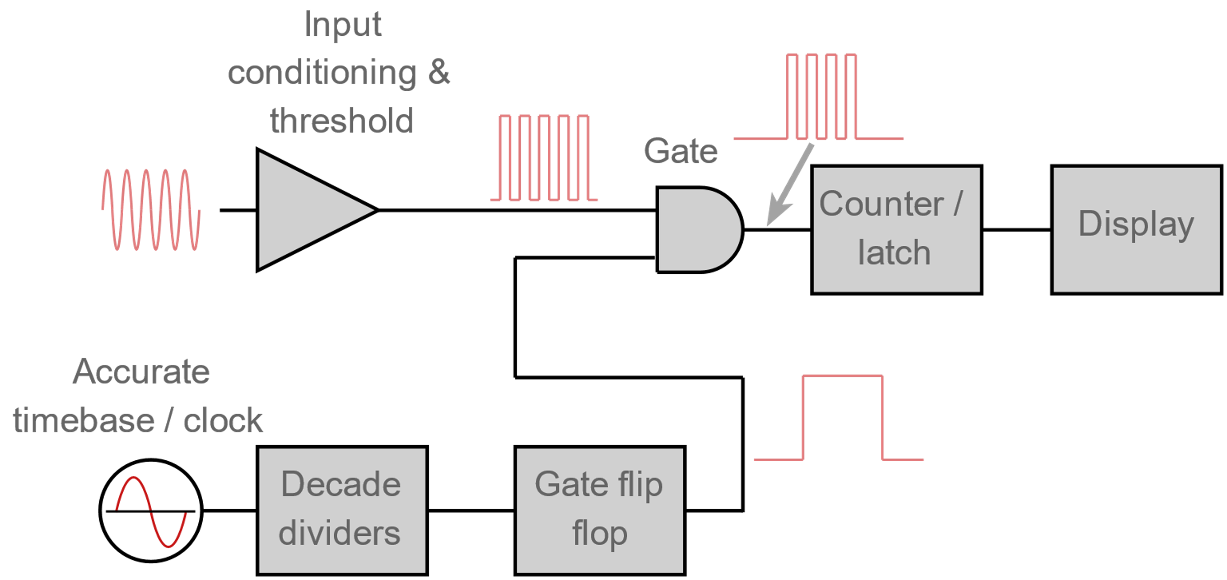
Frequency Meter
A digital frequency counter measures frequency by taking counts of a periodic function over a gate time.
Direct counting methods measure how many times the voltage (or other property being measured) passes a given threshold.
Reciprocal frequency counters measure the period of a cycle and take the inverse.
A clock produces a signal which is divided by the decade dividers into the appropriate gate time.
The “gate flip flop” receives this information and signals when the next set of counts should begin.
The latch holds the last value so that it can continue to be displayed while the counter is updating based on a new set of data.

Slide 6
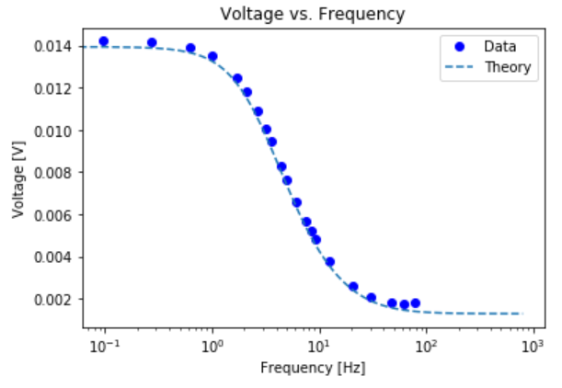
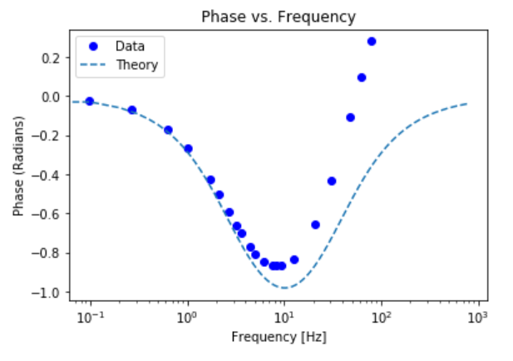
Prediction vs. Data
Voltage Data
We see an almost perfect correlation here, especially in the center.
Asymptotes match fairly well
Standard deviation: 8*10⁻⁸[V]
Phase Data
The left half of the plot appears to be roughly correct.
The dip occurs at the right point.
We have positive phase; this should be impossible with an ideal circuit of our type
Possible explanation: Something within the circuit is behaving as an inductor, producing a field opposing the current, causing the positive phase.
Standard deviation: 0.05 [radians]

Slide 7
Curve Fitting

Slide 8
References
How Does a Frequency Counter Work. (n.d.). Retrieved from Electronics Notes: https://www.electronics-notes.com/articles/test-methods/frequency-counter-timer/how-does-a-frequency-counter-work-operation.php
laserjocky. (2014). Digital Frequency Counter. Retrieved from instructables: https://www.instructables.com/id/Digital-Frequency-Counter/

